Slide 1
Project:Stock Price Prediction Using CNN-BiLSTM-Attention Model course: Applied data science Name: Dinesh.D. Phase:2

Slide 2
Synopsis
Introduction
Model structure
Experiment
Analysis of Results
Model Robust Analysis
Conclusion
Reference

Slide 3
INTRODUCTION
The stock market is an important part of the financial market, and large fluctuations in the stock market can have a large adverse impact on the economy.
If stock prices can be predicted more accurately, stock market crashes can be avoided through targeted actions, and the stock market can be guided to operate well, which will eventually lay a more solid foundation for the healthy development of the financial market .
As a result, the study of intrinsic value and prediction of the stock market has attracted more and more attention from both scholars and practitioners, and a series of results have been achieved .
The rest of the paper is organized as follows. Section 2 presents the description of model structures for the used neural networks. The data and evaluation indicators used in the experiment are unfolded in Section 3. Section 4 displays and explains numerical analysis results. Finally, Section 5 concludes the paper

Slide 4
MODEL STRUCTURE
Convolutional Neural Network(CNN)
The Convolutional Neural Network (CNN) was proposed by Lecun et al. in 1998 . A CNN consists of five major components: input layer, convolutional layer, pooling layer, fully connected layer, and output layer [22]. The convolutional layer and the pooling layer are the focus of the whole model structure, mainly used to extract features and perform dimensionality reduction on features. With its excellent feature extraction and recognition capabilities, CNN has been successfully applied in classification tasks of image and time series data [23]. This study focused on effective nonlinear local feature extraction for stock data using convolutional layers and feature extraction using pooling layer compression to generate more critical feature information.
Long Short-Term Memory Network(LSTM)
Hochreiter and Schmidhuber first proposed Long Short-Term Memory networks (LSTM) in 1997 as a Recurrent Neural Network (RNN) variant [10]. Compared with the traditional RNN, LSTM neural network presents the characteristics suitable for processing and predicting important events with long intervals and delays in time series . LSTM improves the hidden layer structure of RNN by introducing a system of gating units composed of input gates, forgetting gates, and output gates, which effectively alleviates the gradient disappeaRance and gradient explosion problems in model training.
Among them, the forgetting gate is used to decide which information needs to be removed from the neuron in the model, the input gate is used to update the unit state, and the output gate is used to control the output to the next moment of the neuron.

Slide 5
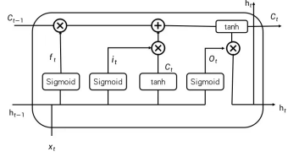
LSTM Memory cell

Slide 6
System Risk Prediction Model
The algorithm flow chart of the Savgol-TCN error correction systemic risk prediction method proposed in this paper and the specific steps are as follows.
ft = σ[Wf (ht−1, xt) + bf ],
it = σ[Wi · (xt , ht−1) + bi ],
Ct = tanh[Wc · (xt , ht−1) + bc],
Ut = it ⊗ Ct + ft ∗ Ct−1,
Ot = σ[Wo · (xt , ht−1) + bo],
ht = Ot ⊗ tanh(Ut),
where ft , it , and Ot are the forgetting gate, the input gate, and the output gate, respectively; Wf , Wi and Wo are the weight coefficient matrices corresponding to the forgetting gate, the input gate, and the output gate, respectively; bf , bi and bo denote the offset constants corresponding to the forgetting gates, input gates, and output gates, respectively; Ut is the state of the neuron; ht is the output of the hidden layer; σ is the Sigmoid function; and ⊗ is the Hadamard product
Bidirectional long short-term Memory
A Bidirectional Long Short-Term Memory (BiLSTM) neural network is an optimized improvement of LSTM. While the traditional LSTM predicts the next moment’s output by past time series information, BiLSTM can fully take into account past and future information by connecting a forward LSTM layer and a backward LSTM layer, which facilitates both forward and backward sequence information input, thus making the model more robust.
The formulas of each part of BiLSTM are given below.
Ai = f1(ω1xi + ω2Ai−1),
Bi = f2(ω3xi + ω4Bi+1),
Yi = f3(ω5Ai + ω6Bi),
where f1, f2, and f3 are the activation functions of their corresponding layers.

Slide 7
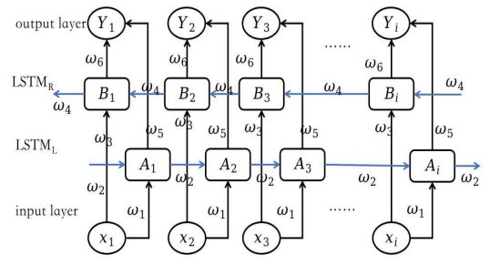
BiLSTM Structure

Slide 8
Attention Mechanism
The attention mechanism originated from studies of human vision. Traditional neural networks cannot distinguish the importance of signals in processing information. At the same time, the attention mechanism can assign different weights according to different features, that is, to assign greater weights to critical information and choose to discard unimportant information to improve the efficiency of information processing through differentiated weight assignment and solve the problem of information loss caused by long sequences in LSTM. Therefore, the attention mechanism’s introduction may further improve stock price prediction accuracy.
CNN-BILSTM-Attention Prediction Model Compostion
As pointed out earlier, forecasting stock (or other asset) prices is so crucial that scholars have tried to use various methods for that purpose. There is a lot of room to enhance prediction accuracy, especially with the help of new development in technologies. This paper proposed a stock closing price prediction method based on the CNN-BiLSTMAttention model. The process of this method can be described as follows.
Step 1: The collected stock data were normalized and divided into training and testing levels.
Step 2: First, the CNN layer was used to extract the internal features of the stock data, and the CNN layer consists of a 2D convolutional layer, a pooling layer, and a dropout layer. Then, the BiLSTM layer was trained on the local features extracted by the CNN to learn the internal dynamic change pattern. An attention mechanism was introduced to automatically assign different weights to the features extracted by the BiLSTM layer to explore the deep temporal correlation. Finally, the output was passed through a dense layer.
Step 3: The prediction results were normalized to obtain the desired values.

Slide 9
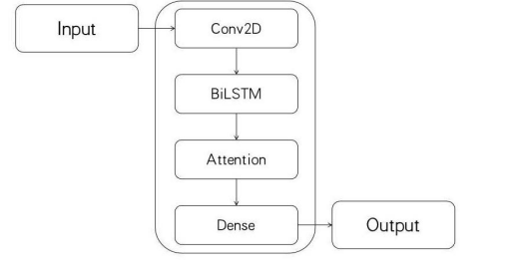
CNN-BiLSTM-Attention neural network

Slide 10
EXPERIMENT
Data Description
This paper selected the data of the CSI 300 Index from 4 January 2011 to 31 December 2021, a total of 2675 trading days for stock price prediction and predicting the closing price. The Shanghai Shenzhen CSI 300 Index is one of China’s most closely followed stock market indices. It includes the 300 A-share stocks traded on the Shanghai and Shenzhen stock exchanges and is seen as indicative of trends in both those markets. The selected features include opening price, highest price, lowest price, closing price, volume, turnover, and return. A direct single-step prediction strategy was used. The ratio of the data used for the training set, test set, and validation set is 6:2:2.
Data Pre-Processing
There is a large scale between the feature data in this paper. In order to eliminate the influence of the scale between the features, the data set was normalized in this paper. The normalization process is helpful to speed up the convergence of the loss function, prevent the gradient explosion in the network training, and improve computational accuracy. In this paper, the data were normalized to [0, 1] using Min-Max normalization, and the calculation process is shown in Equation (1). x ∗ i = xi − xmin/ xmax − xmin (1)

Slide 11
where xi is the original data, x ∗ i is the normalized value, xmin and xmax are the minimum and maximum values of the original data, respectively. Since the data normalized by the model are also normalized, the output data are denormalized by the flip-flop process. The calculation formula is shown in (2).
x ∗ = y ∗ (xmax − xmin) + xmin, (2)
where y ∗ is the normalized stock price forecast. x ∗ is the actual stock price forecast value obtained after denormalization.
Evaluation Indicators This paper used three evaluation indicators, Mean Absolute Percentage Error (MAPE), Root Mean Square Error (RMSE), and coefficient of determination R 2 , to evaluate the model prediction performance. They are calculated by Equations (3), (4) and (5), respectively.
MAPE = 1 n n ∑ i=1 | y1 − y 0 i yi | × 100%, (3)
RMSE = s 1 n n ∑ i=1 (y1 − y 0 i ) 2 , (4)
R 2 = 1 − ∑ n i=1 (y1 − y 0 i ) 2 ∑ n i=1 (y1 − y¯ 0 i ) 2 , (5)

Slide 12
ANALYSIS OF RESULT
To further verify the superiority of the CNN-BiLSTM-Attention model proposed in this paper for short-term stock price prediction, the LSTM model, CNN-LSTM model, and CNN-LSTM-Attention model were selected as the comparative models for analyses.
The horizontal axis represents the number of days, the vertical axis represents the stock prices, the solid orange line is the actual stock closing price, and the solid blue line is the predicted stock closing price with the corresponding model.
That is, the CNN-BiLSTM-Attention model is the most accurate among these four models for the prediction of CSI 300 with the selected range of data.
Compared with the prediction results of the other three models, it can be seen that the CNN-BiLSTM-Attention model had higher accuracy in predicting stock closing prices, and the predicted values matched the changes in the actual values
Its prediction curve was similar to the proper value curve. Both LSTM and CNN-LSTM models had the phenomenon of “discontinuity” in the prediction of closing indices and CNN-LSTM-Attention.
The CNN-BiLSTM-Attention achieved the best prediction effect, probably because the bi-directional LSTM model fully uses the relationship between the forward and backward time dimensions on the time series, which can obtain more feature information and thus improve the prediction accuracy of the model.

Slide 13
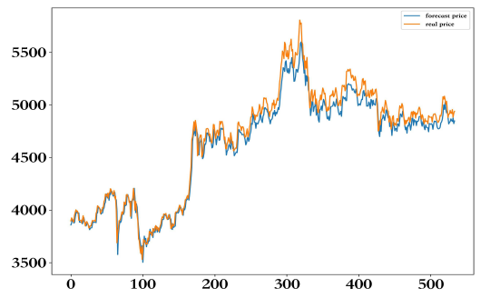
Prediction results based on LSTM

Slide 14
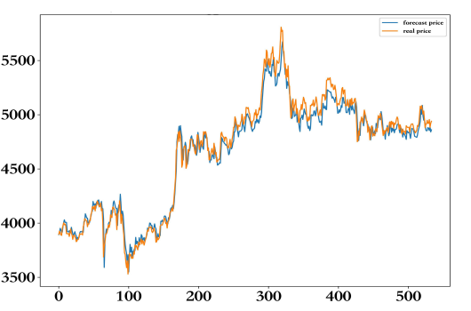
Prediction results based on CNN-LSTM

Slide 15
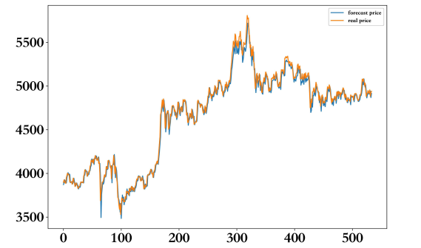
Prediction results based on CNN-LSTM-Attention

Slide 16
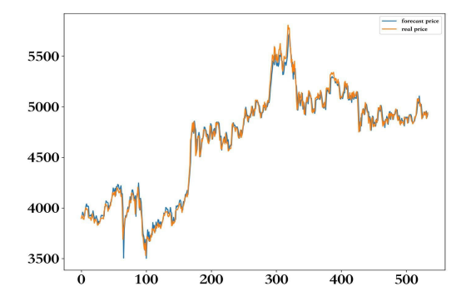
Prediction results based on CNN-BiLSTM-Attention

Slide 17
The above comparisons with figures are very intuitive but also quite rough. To quantify the comparison of prediction results, the values of the three quantities calculated by Equations (3)–(5) for the four models with the index are shown in Table 1, where the best result among the models is in boldface (similarly for other tables).

Slide 18
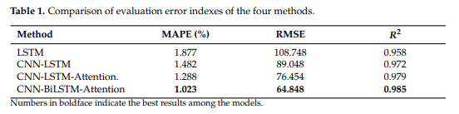

Slide 19
MODEL ROBUST ANALYSIS
To further verify the accuracy and robustness of the model proposed in this paper, the CNN-BiLSTM-Attention model and three other models will be used to predict the closing prices of the Chinese and international stock market indices to obtain the test errors. The Chinese index is selected as the SSE A-share index, SSE Composite index, and SZSI constituent index, and the international index is chosen as AEX (Amsterdam Exchange index), ATX (Austrian Traded Index), FCHI (CAC 40 Index), FTSE (Financial Times Stock Exchange 100 Index), HSI (Hang Seng Index), JKSE (Jakarta Stock Exchange), KLSE (Kuala Lumpur Stock Exchange), and OEX (S&P 100)
Model Robust Analysis Based on Chinese Market Indices
The data were selected for stock price prediction from 4 January 2011 to 31 December 2021 (at the time when the project was started), for a total of 2675 trading days; the closing price trends of the stock indices

Slide 20
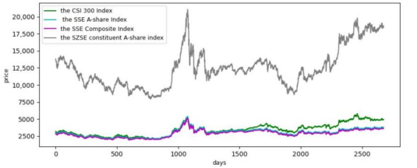
Trends of Chinese Stock Indices

Slide 21
The figure shows that the four selected stock indices generally have similar trends, especially the SSE A-share Index, SSE Composite Index, and CSI 300 Index. The normalization would eliminate the effect of the magnitude, and the hyperparameters used in the prediction would remain unchanged.
To save space, the comparison of the prediction of each index mentioned above by the chosen four models is plotted in one figure. The meaning is similar to the explanation given above—the closer the curve of a model to the actual curve, the better the model. The prediction results are shown in Figures 9–11, respectively. It can be seen that the CNNBiLSTM-Attention model has good generalization ability and good robustness. However, the local prediction accuracy of the model decreases at the spikes in the stock price.

Slide 22
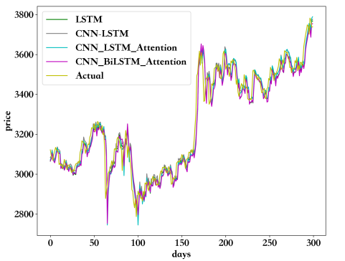
Comparison of SSE A-share Index prediction results.

Slide 23
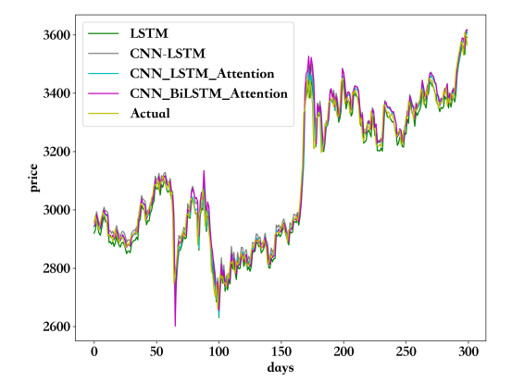
.Comparison of SSE Composite Index prediction results

Slide 24
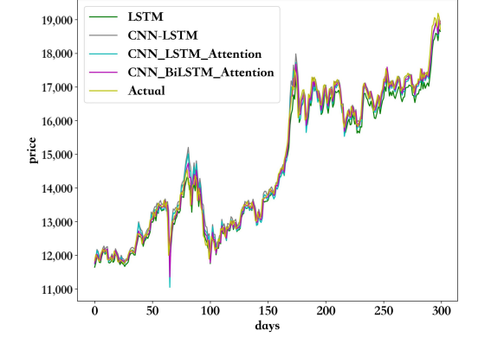
Comparison of SZSE Component A-Share Index prediction results

Slide 25
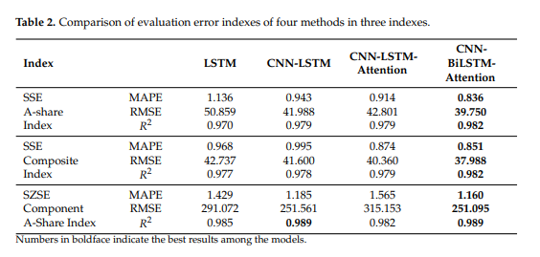

Slide 26
Table 2 shows that the CNN-BiLSTM-Attention model outperforms other models in predicting the closing prices of the SSE A-share Index, the SSE Composite Index, and the SZSE Component A-share Index. The analysis of SSE A-share Index prediction results shows that the RMSE value of the CNN-BiLSTM-Attention model is 7.13% lower than that of the second-best model, CNN-LSTM-Attention, and the R 2 value has also improved. The analysis of the prediction results for the SSE Composite Index shows that the CNN-BiLSTMAttention model has a 5.88% lower RMSE value and an improved R 2 value compared with the CNN-LSTM-Attention model. The analysis of the prediction results of the SZSE constituent A-share index shows that the RMSE value of the CNN-BiLSTM-Attention model is 20.3% lower than the second-best model, CNN-LSTM-Attention, and the R 2 value is improved from 0.982 to 0.989, which indicates that the prediction accuracy of the model has been improved. Meanwhile, one can see from Table 2 that the MAPE and R 2 of the three indices are similar. Still, the RMSE of the SSE A-share Index and SSE Composite Index is much lower than that of the SZSE Constituent A-share Index due to the difference in the original data outline, and the mean square error will be different.
Model Robust Analysis Based on International Market Indices Eight international indices, namely AEX, ATX, FCHI, FTSE, HSI, JKSE, KLSE, and OEX, were selected to forecast their closing prices and derive test errors by selecting characteristics including opening price, high price, low price, closing price, volume, and return. The trading data from 3 January 2011 to 29 October 2021 are selected. The data are first normalized to eliminate the effect of volume, and the hyperparameters used for forecasting are unchanged. The comparisons of the prediction results of these indices are shown in Figures 12–19, where the meaning for each figure can be explained similarly to the previous ones. The curve of the predicted results of the CNN-BiLSTM-Attention model is closest to the curve of the actual data in general. That is, the CNN-BiLSTM-Attention model is the most accurate among these four models. Compared with the forecast results of the Chinese indices, the international indices have more lagging forecasts, which is probably related to the “T+1” trading system in China and the “T+0” system in the international markets.

Slide 27
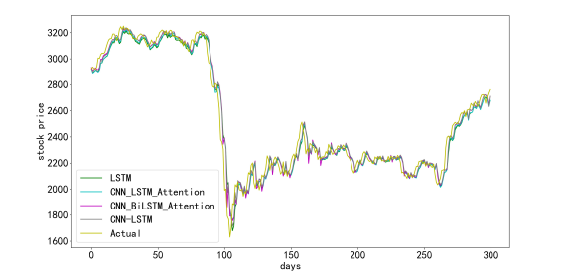
Comparison of AEX Index prediction results

Slide 28
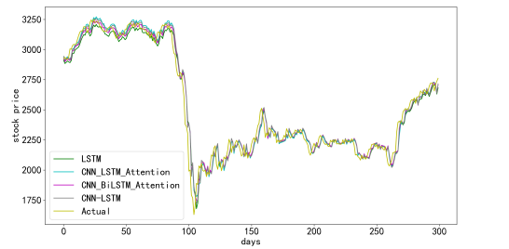
Comparison of ATX Index prediction results.

Slide 29
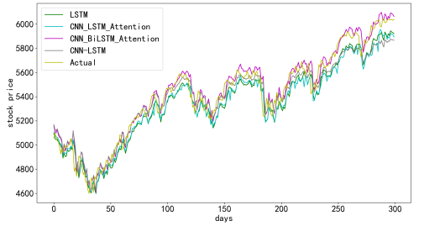
Comparison of FCHI Index prediction results

Slide 30
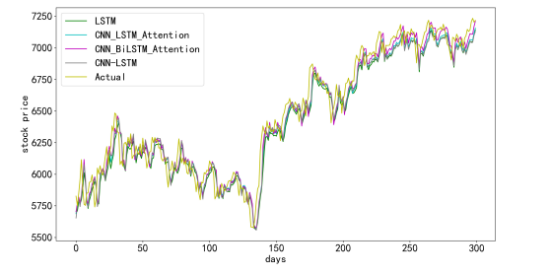
Comparison of FTSE Index prediction results

Slide 31
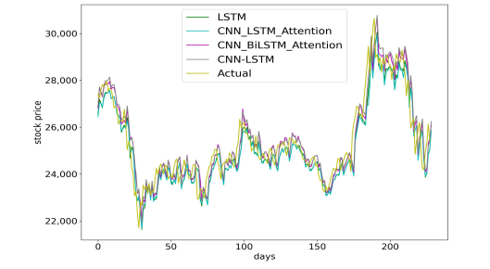
Comparison of HSI Index prediction results

Slide 32
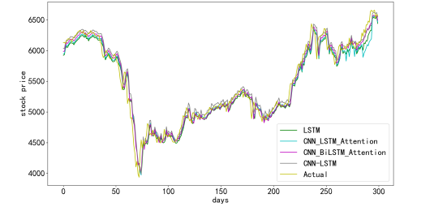
Comparison of JKSE Index prediction results

Slide 33
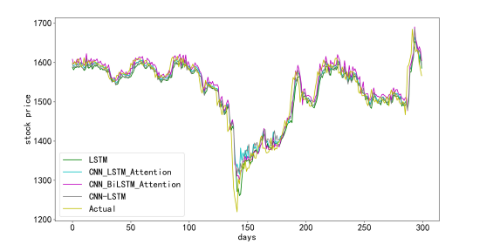
Comparison of KLSE Index prediction results.

Slide 34
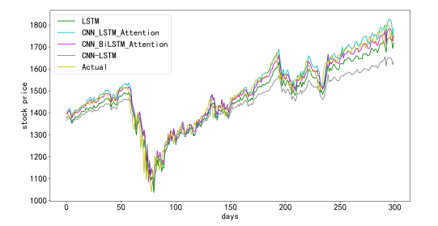
.Comparison of OEX Index prediction results.

Slide 35
Once more, the above comparisons with figures are very intuitive but also quite rough. To quantify the comparison of prediction results, the values of the three quantities calculated by Equations (3)–(5) for the four models with each index are shown in Table 3. Table 3 shows that the CNN-BiLSTM-Attention model outperforms the LSTM, CNNLSTM, and CNN-LSTM-Attention models in predicting stock index prices, with the smallest mean absolute percentage error and root mean square error and the coefficient of determination closest to 1. Analysis of the AEX prediction results shows that the CNN-BiLSTMAttention model RMSE value is 7.6% lower than the second value and the ATX prediction results show that the CNN-BiLSTM-Attention model RMSE value is 7.6% lower than the second value. The RMSE value of the CNN-BiLSTM-Attention model is 7.6% lower than the second value; the RMSE value of the ATX model is 5.9% lower than the second value; the RMSE value of the FCHI model is 5.9% lower than the second value; and the RMSE value of the CNN-BiLSTM-Attention model is 7.6% lower than the second value. As a result, the RMSE value is 32.8% lower than the second value, and the R 2 value increases from 0.967 to 0.985; the analysis of the FTSE prediction results shows that the RMSE value of the CNN-BiLSTM-Attention model is 10.7% lower than the second value;
the study of the prediction results indicates that the RMSE value of the CNN-BiLSTM-Attention model is 3.3% lower than the second value; the analysis of the JKSE prediction results showthat the RMSE value of the CNN-BiLSTM-Attention model is 16.3% lower than the second value; the study of the KLSE prediction results shows that the RMSE value of the CNNBiLSTM-Attention model is 1.3% lower than the second value; and the analysis of OEX prediction results shows a 2.7% reduction in the RMSE value of CNN-BiLSTM-Attention model compared to the next value. This indicates that the prediction accuracy of the model has been improved.

Slide 36
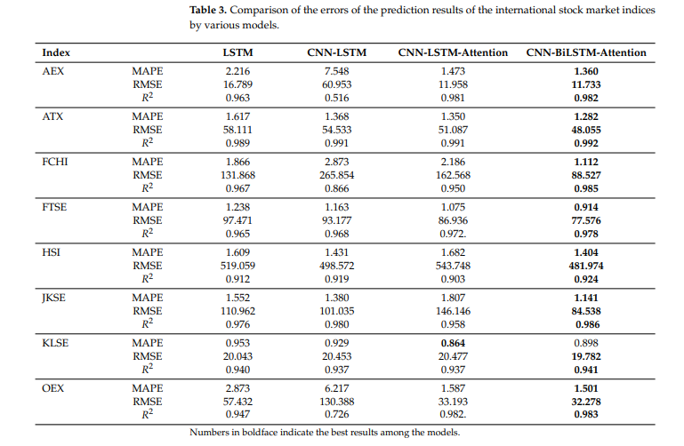

Slide 37
CONCLUSION
Asset (such as stock) price forecasting is very important in financial investment activities. Accurate prediction is challenging due to the complexity of the issue. Therefore, the state-of-the-art available methods and technologies are used to predict asset prices, from RNN, LSTM, CNN-LSTM, biLSTM, CNN-biLSTM, etc. This process will continue as new methods or technologies appear. In order to improve the accuracy of stock price prediction, the combination of the CNN-BiLSTM and the attention mechanism, i.e., the CNN-BiLSTM-Attention model, is proposed for price prediction in this paper first using the CSI 300 index data. The test results show that the CNN-BiLSTM-Attention model achieves the best accuracy in stock price index prediction among the four models—LSTM, CNN-LSTM, CNN-LAST-Attention, and CNN-BiLSTM-Attention.
To conduct the model stability analysis of the proposed model, the above four models were used to predict stock prices or indices using 12 stock market index data chosen from China and abroad. Again, the test results show that the proposed model can effectively predict stock indices of the stock markets in China and other countries, indicating that the proposed model has a certain degree of generalizability. However, the evaluation index used in this paper is stock trading data, and there are many factors affecting a stock price or index in a financial market.
So, just like other models, there are also limitations to the proposed model, mainly due to the model structure. To further improve the prediction accuracy, more work can be done, such as the integration of stock multi-source heterogeneous information into the index, or combining the most up-to-date models, or even developing new models, which is difficult, of course. Due to time and space limitations, the authors did not perform the test of the methods used in this study with data in North American markets, although it is believed that a similar conclusion can be obtained. All these could be considered in future work.

Slide 38
Author Contributions: Methodology, Y.L.; Software, L.Y.; Validation, L.Y.; Formal analysis, Y.L.; Investigation, J.Z. and L.Y.; Data curation, L.Y.; Writing—original draft, L.Y.; Writing—review & editing, Y.L.; Supervision, J.Z.; Project administration, J.Z. and Y.L.; Funding acquisition, J.Z. and Y.L. All authors have read and agreed to the published version of the manuscript
Funding: This research was supported by the Natural Science & Engineering Research Council (NSERC) of Canada (RGPIN-2019-05906) and the National Science Fund of Fujian Province (No:2020J01892).
Data Availability Statement: Data used in the paper are available upon request.
Acknowledgments: The authors are very grateful to the Editor and three anonymous Reviewers for their help, valuable suggestions, and comments.
Conflicts of Interest: The authors declare no conflict of interest.

Slide 39
REFERENCE
Yu, W.; Peng, W. Forecasting volatility of ssec in the Chinese stock market using multifractal analysis. Phys. Stat. Mech. Appl. 2008, 387, 1585–1592.
Wang, P.; Lou, Y.; Lei, L. Research on Stock Price Prediction Based on BP Wavelet Neural Network with Mexico Hat Wavelet Basis. In Proceedings of the 2017 International Conference on Education, Economics and Management Research (ICEEMR 2017), Singapore, 29–31 May 2017; pp. 99–102.
Hao, Y.; Gao, Q. Predicting the trend of stock market index using the hybrid neural network based on multiple time scale feature learning. Appl. Sci. 2020, 10, 3961.
Dwivedi, S.A.; Attry, A.; Parekh, D.; Singla, K. Analysis and forecasting of Time-Series data using S-ARIMA, CNN and LSTM. In Proceedings of the 2021 International Conference on Computing, Communication, and Intelligent Systems (ICCCIS), Greater Noida, India, 19–20 February 2021; pp. 131–136.
Parmar, K.; Singh, S.; Kumar, J. Soft computing models coupled with statistical models estimate the future of the stock market. Neural Comput. Appl. 2021, 33, 7629–7647.

